Slide 1


CEIS106 Intro to Operating Systems
Final Course Project
Jonathan Waugh

Slide 2

Introduction
This presentation covers my five-part project completed while taking CEIS 106 Introduction to Operating Systems
It includes examples of operating system concepts by examining Windows, Linux, mobile, and virtual based systems. Computing system architectures and devices are considered. Basic scripting is introduced.
The objective of this presentation is to give the viewers a better understanding of Windows, Linux, mobile, and virtual based systems.

Slide 3


Linux Filesystem Hierarchy
Explored the Linux filesystem tree and common Linux commands used to manage directories and files

Slide 4

Navigate the Linux filesystem tree
1.What is the pwd command an acronym for? What about the cd command?
pwd=Print Working Directory- shows current directory path
cd=change directory-change to directory that you specify
2. Explain the differences between a relative path and an absolute/full path in Linux?
Absolute path – path starting from the very top of the filysystem, which is the root .. /
Relative path – path based on your current location

Slide 5
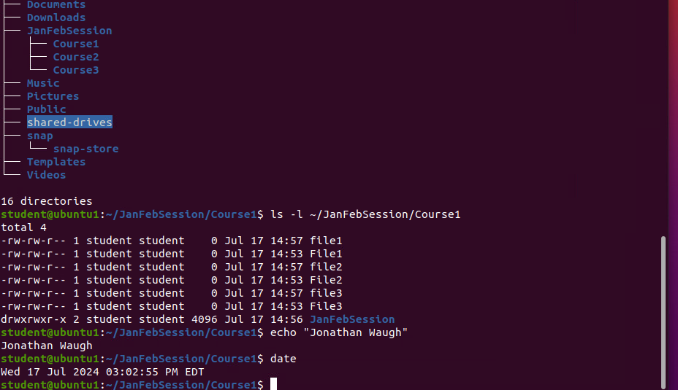
Create directories and files

Slide 6
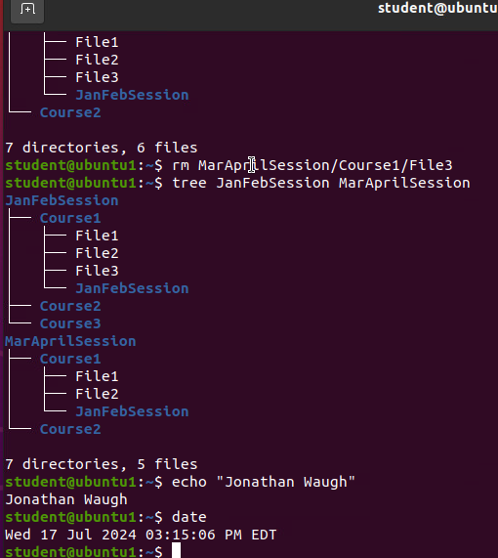
Copy and remove directories and files

Slide 7
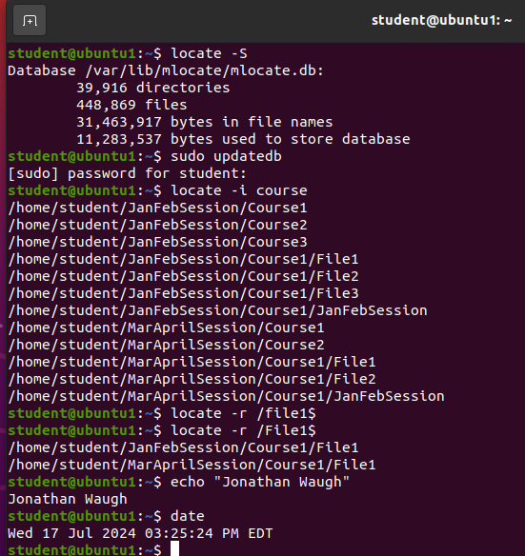
Locate directories and files

Slide 8

Linux shell script
Create/execute a shell script by experimenting with the standard input, user-defined variables, redirection, file permissions, and environment variables

Slide 9
Create a shell script
1. What are the file permissions of the script?
rw- rw- r–
read-/write for the owner, read/write for the group, read only for everyone else
2. What’s the name of the user-defined variable in the script?
text
3. Which redirection meta-character is used in the script? What does it do?
>> --redirection to the file and appends to the end of the file

Slide 10
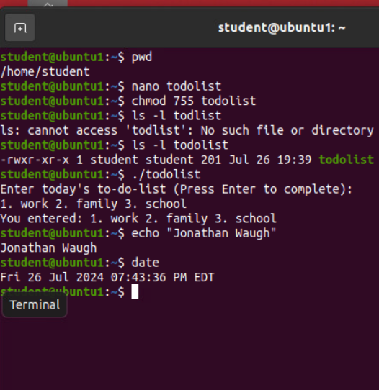
Change script file permissions

Slide 11
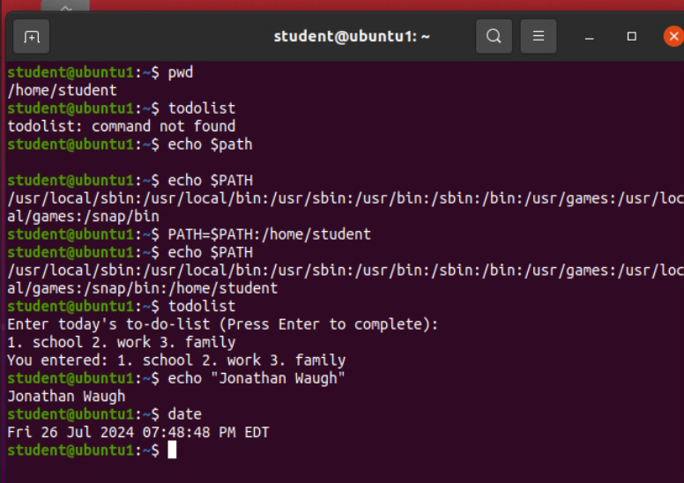
Set the PATH variable

Slide 12
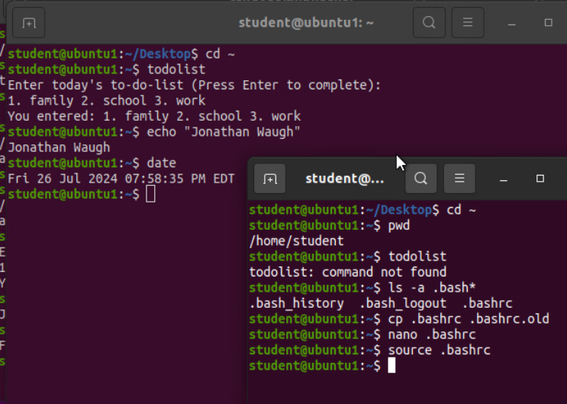
Make the PATH variable permanent

Slide 13

User and group management
Tested user and group setting
Added groups in CLI and GUI
Removed users and groups

Slide 14
Add users and groups in CLI
1. What does the –m option in the useradd command do?
Tells useradd command to create a home directory for this new user
2. What does the -3 option in the tail command do?
Tells tail command how many lines to show
3. Which line of the /etc/group file lists members of the “students” group? Copy it here.

Slide 15
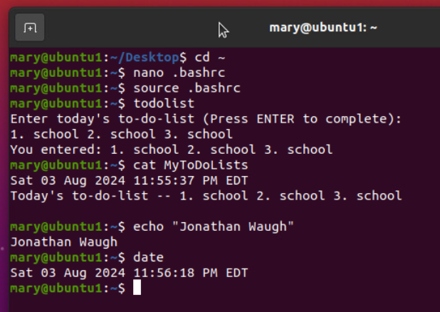
Test user and group settings

Slide 16
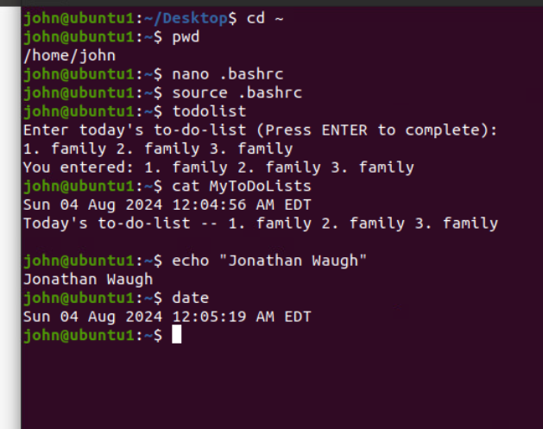
Add users in GUI

Slide 17
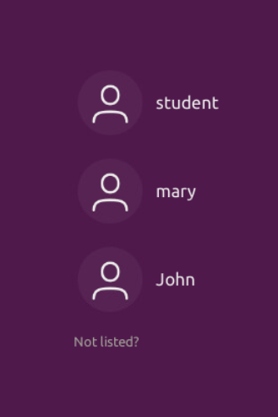
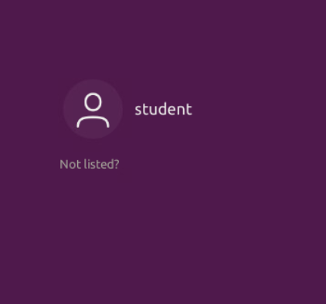
Remove users and groups

Slide 18

Network configuration
Used commands to manage network interfaces, discover host ip config, and use network utilities

Slide 19
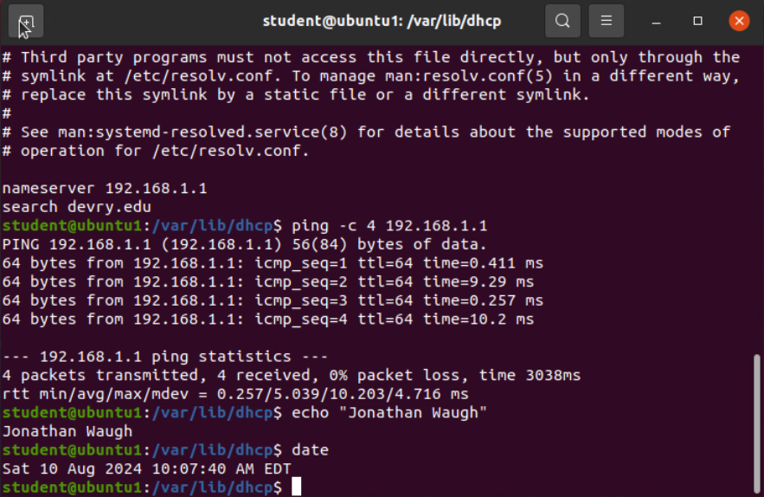
Discover host IP configurations
1. What is the IP address of your Ubuntu machine?
192.168.1.107
2. What is the IP address of its default gateway?
192.168.1.1
3. What is the IP address of its DHCP server?
192.168.1.1
4. What is the IP address of its DNS server?
192.168.1.1

Slide 20
Manage network interfaces
Which DHCP message is shown in the output of the sudo dhclient –v –r eth0 command?
DHCPRELEASE
2. Which four DHCP messages are shown in the output of the sudo dhclient –v eth0 command?
DHCPDISCOVER
DHCPOFFER
DHCPREQUEST

Slide 21
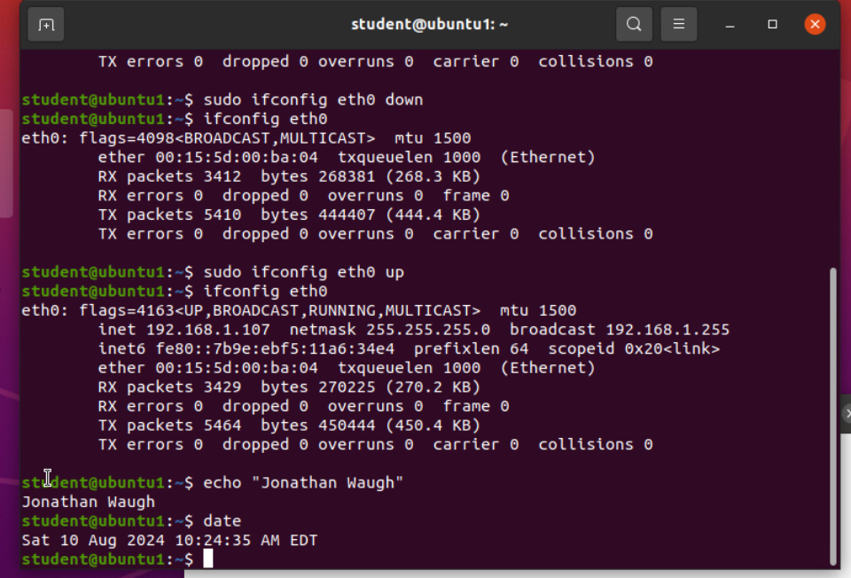
Use network utilities

Slide 22

System Performance Monitoring
Monitor processes, user activities, and network bandwidth usage

Slide 23
Monitor Linux processes
1. What is the default action of the 15 SIGTERM kill signal?
Kill the highlighted process
2. In the System Monitor window, click on % CPU to sort the processes by CPU load. Which process shows the highest percentage of CPU usage?
gnome-shell (GUI)

Slide 24
Monitor user activities
Issue the sudo accton on command to turn on GNC accounting. Run the sudo updatedb command. Enter lastcomm updatedb to check if the updatedb command was executed before. Remember to turn off GNC accounting (sudo accton off) after answering the questions.
1. What flag value is displayed in the output?
S --Super User
2. Why is the name of the user who ran the processes shown as root, not student?
superuser – since we typed sudo in front of the command

Slide 25
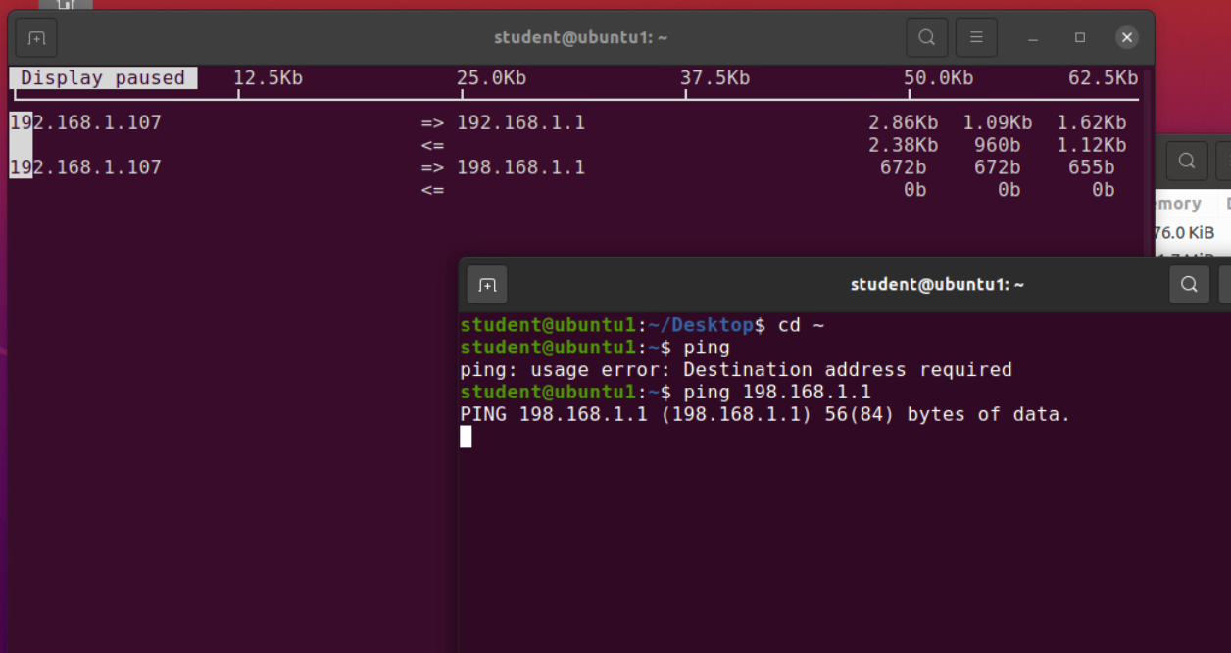
Monitor network bandwidth usage

Slide 26

Challenges
Linux being case sensitive
I overcame these obstacles by reviewing the project guide to make sure i had everything correct as not to waste time or run into errors thus wasting more time
The lessons I learned was words matter and make a huge difference in whether your code works or not

Slide 27

Career Skills
Linux history
Navigating directories and filesystems
Basic commands
Setting permissions
Adding, deleting, and modifying users
IP configurations and networking
Monitoring processes, activities, and usage

Slide 28

Conclusion
This class provided a great introductory to Linux operating systems. With Linux, I can customize a server environment to fit a specific need, whether hosting websites, managing databases, or running applications. I feel even more confident in my ability to accomplish tasks that use Linux OS after coming into this class being self taught. I am excited too continue too learn more and hone my skills to help advance me in my future career path. Embracing Linux will open a world of possibilities in the digital realm, empowering myself to build, innovate, and collaborate effectively.

Slide 29
References
Live Lessons
Eckert, J.W. (2019) CompTIA Linux+ guide to Linux certification (5th ed). Boston, Massachusetts, Cengage Learning
Previous self-taught research from multiple websites and videos

