Slide 1
Python Final Presentation
Jonathan Waugh

Slide 2

Introduction
Python is #1 programming language in the world
Python is used extensively in AI
Python is used for many career fields from cybersecurity to data analytics

Slide 3

Design and Setup
Created a flowchart to design the course project
Created a small Python application with input, processing, and output

Slide 4
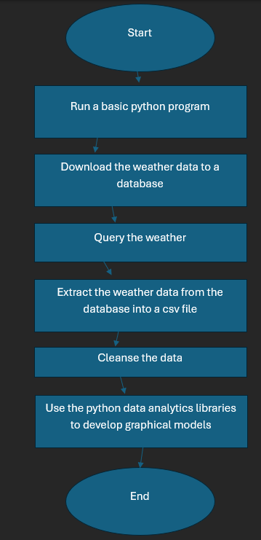
Flowchart
Include the following processes:
  Run a basic python program
  Download weather data to a database.
  Query the weather data
  Extract weather data from database into a comma separated file with python
  Cleanse weather data
  Use python data analytics modules to develop graphical models

Slide 5
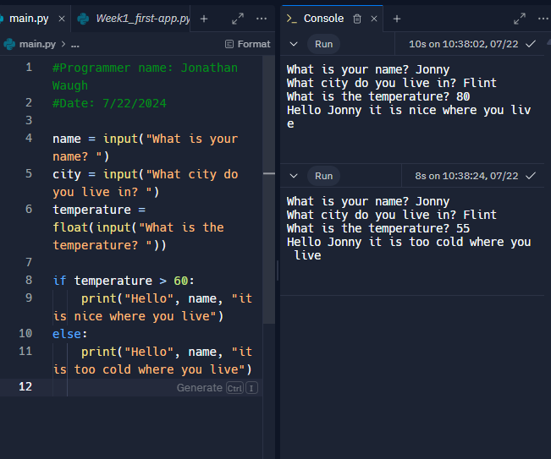
Python program
(Screenshot)

Slide 6

Downloading Weather Data
Used code to download weather data from NOAA api
Ran code and created weath.db, which is a database file

Slide 7
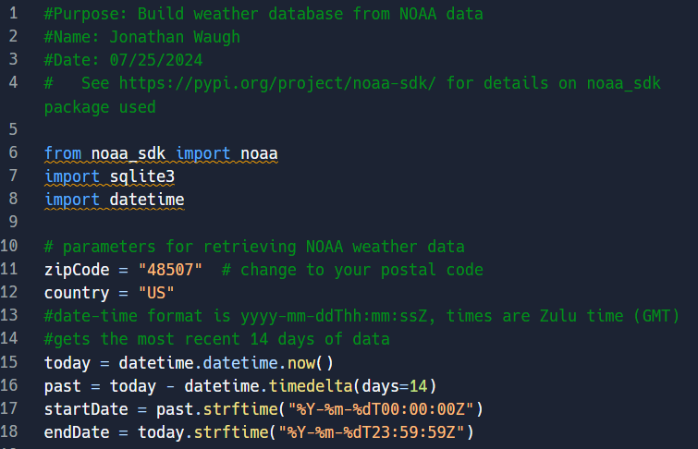
BuildWeatherDb.py Code

Slide 8
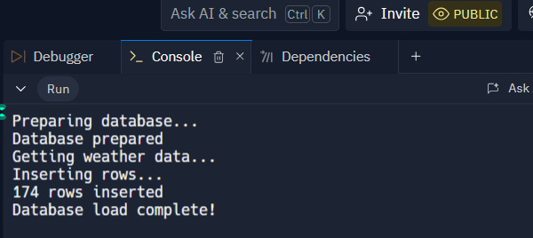
Python Console
(Screenshot)

Slide 9
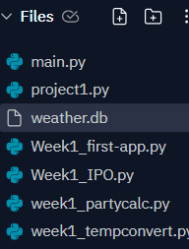
Weather.db File
(Screenshot)

Slide 10

Querying a Database with SQL
Used code to query to retrieve weather information from database
Pulled lowest and highest temperature days
Pulled all clear days

Slide 11
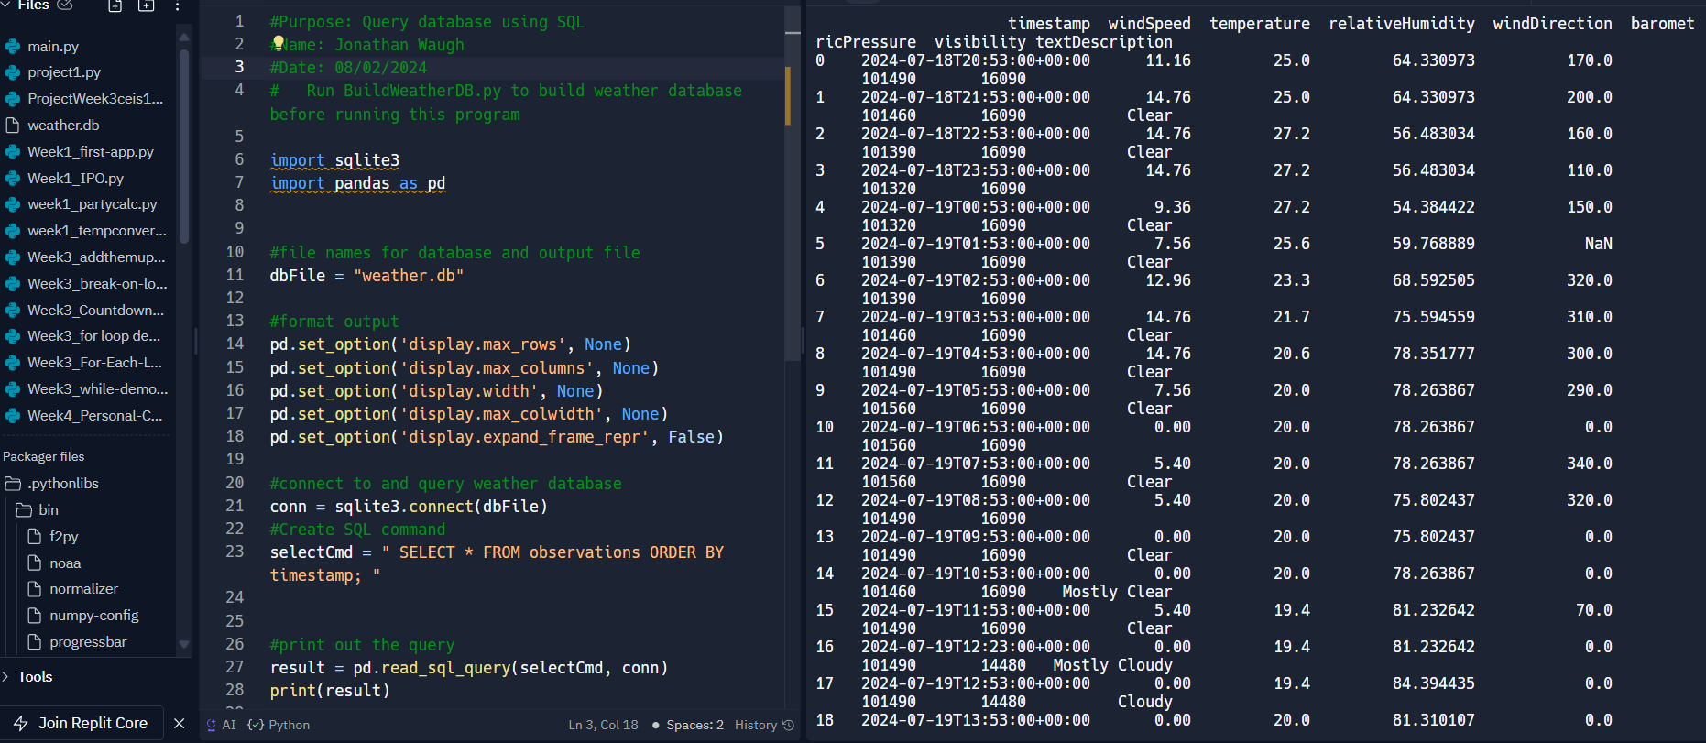
Query to retrieve all columns and all rows (Screenshot)
Screenshot of SQL query command and results

Slide 12
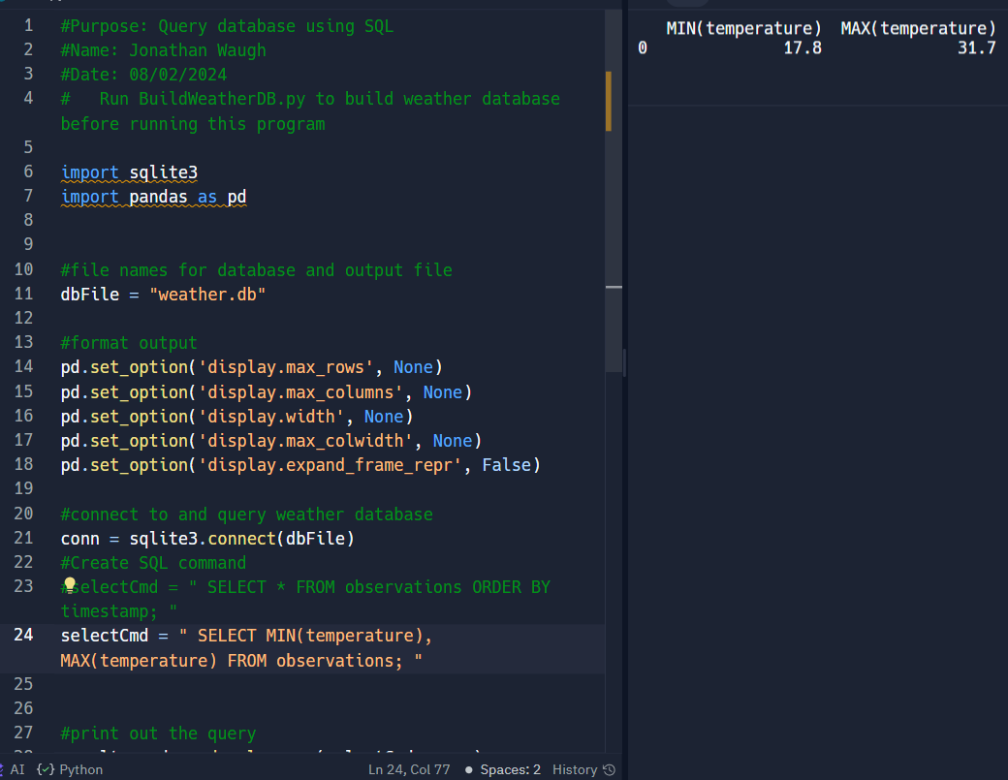
Query to retrieve lowest and highest temperatures
(Screenshot)

Slide 13
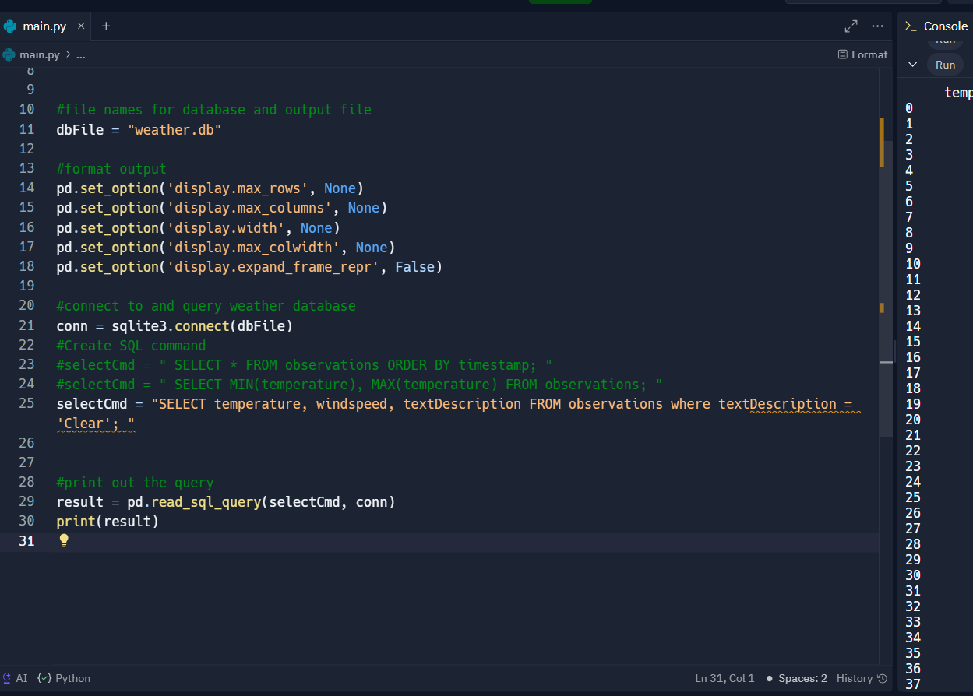
Query to retrieve all clear days
(Screenshot)

Slide 14

Querying and Manipulating data with SQL and Python
Retrieved and converted data into CSV format
Created a temperature and humidity chart

Slide 15
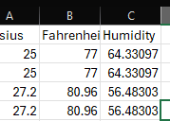
Retrieve and Convert Data to CSV Format (Screenshot)

Slide 16
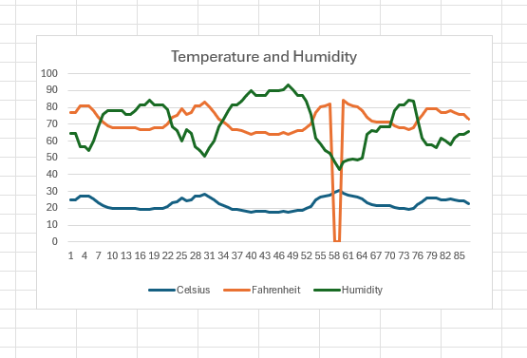
Temperature and Humidity Chart
(Graph)

Slide 17

Graphical Models
Created a graphical model of data
Created analysis
Developed prediction based on data analysis

Slide 18
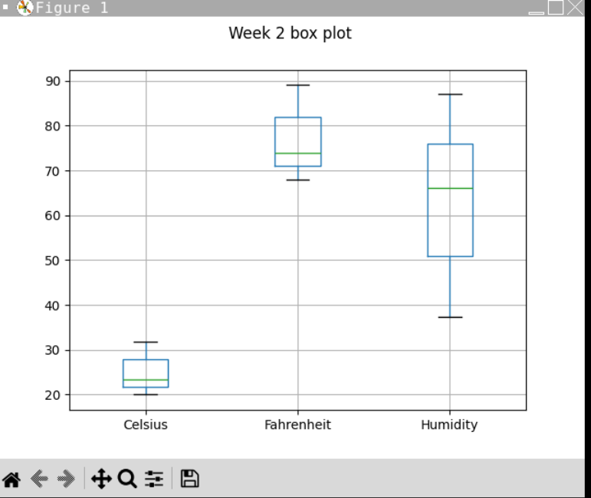
Plot #1

Slide 19
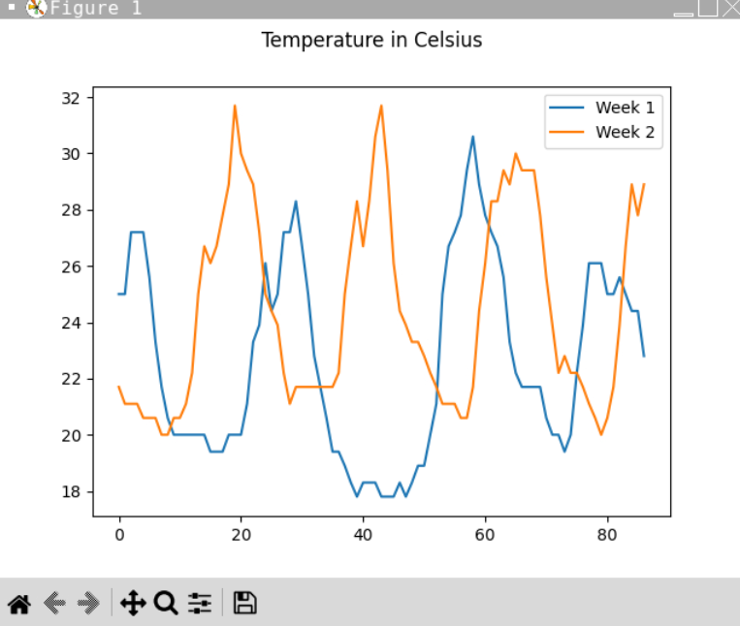
Plot #2

Slide 20
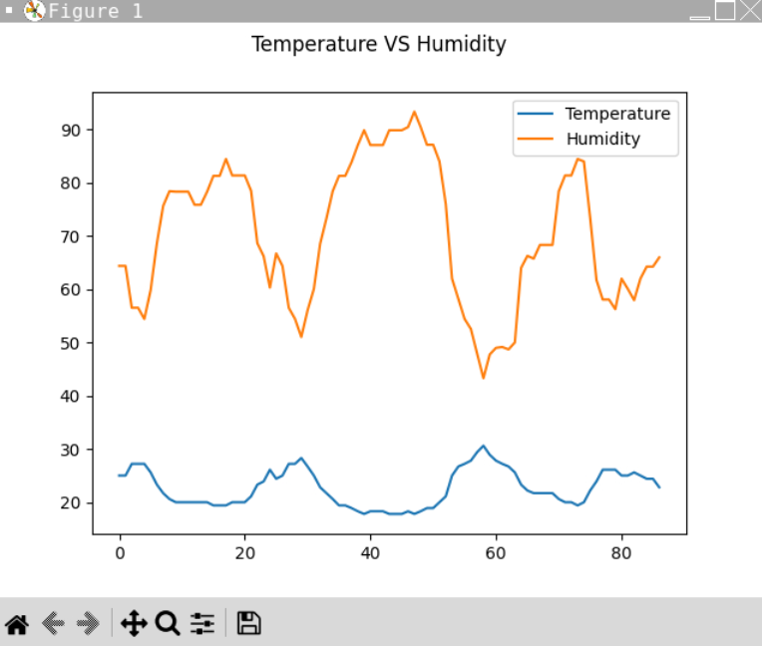
Analysis
Supported by Chart:
There is an inverse relationship between temperature and humidity.

Slide 21

Prediction
My prediction based on the data is when the temperature decreases over the next few months the humidity will rise and we will begin to see snow for the winter months.

Slide 22

Challenges
Indentation, the use of tabbing
Python being case sensitive

Slide 23
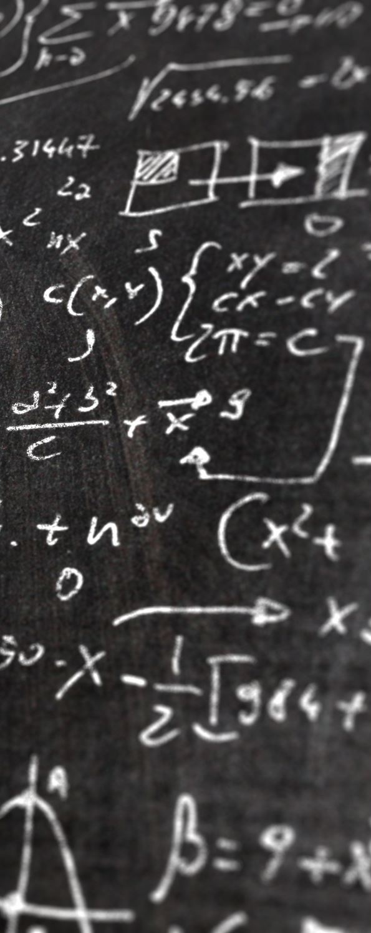
Career Skills
Attention to details which was reinforced by this class
Problem-solving skills
Python programming language
Using web APIs

Slide 24

Conclusion
Programming can benefit the entire world
I was able to reinforce my skills and learn new techniques
Coding is extremely satisfying when you get it right

